Slide 1
IoT based Traffic Light Control and Monitoring System using ESP32, AWS and Blynk IoT

Slide 2
INTRODUCTION
In the realm of smart city infrastructure, IoT-based traffic monitoring systems play a pivotal role in ensuring smooth traffic flow and enhancing road safety. Our project utilizes the ESP32 microcontroller along with ultrasonic sensors to detect vehicle presence at traffic signals. The collected data is then transmitted to an AWS server for real-time analysis and visualization. This innovative system not only provides valuable insights for traffic management but also lays the foundation for a more efficient and interconnected urban transportation network.

Slide 3
Block diagram
LED SIGNAL 1
LED SIGNAL 3
LED SIGNAL 2
LED SIGNAL 4
Ultrasonic sensor(for signal 1)
ESP32
Ultrasonic sensor(for signal 2)
Cloud
Ultrasonic sensor(for signal 3)
Ultrasonic sensor(for signal 4)

Slide 4
HARDWARE
COMPONENTS
SOFTWARES
Arduino ide
Aws
Blynk
Esp32 microcontroller
Ultrasonic sensors
Led lights (Red,Yellow,Green)
Resistors
Battery

Slide 5
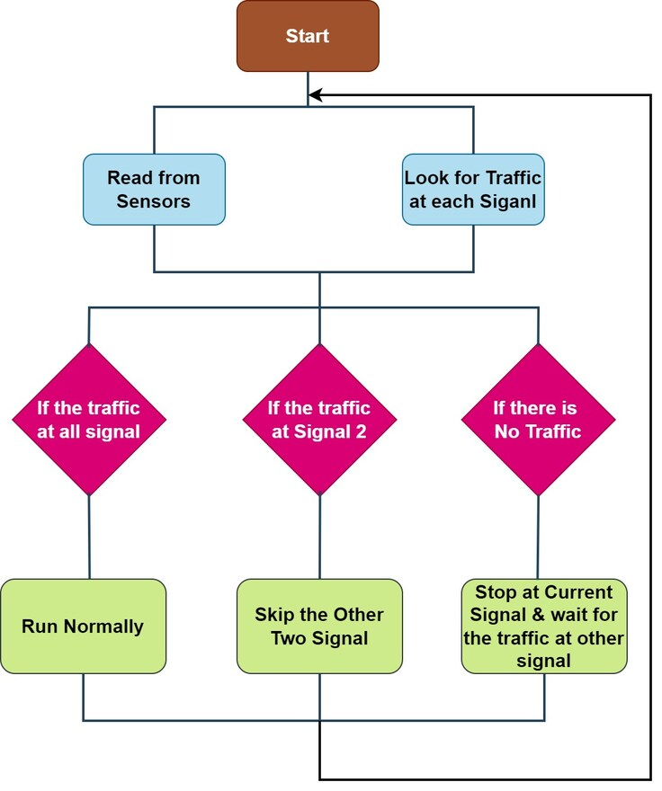
METHODOLOGY

Slide 6
IMPLEMENTATION
ESP32:
Esp32 collects the data from the sensor and operates the output devices and also sends the data to the cloud.
Ultrasonic sensors:
Ultrasonic sensors are used to detect traffic.
LED Lights:
Led lights are used to describe the traffic signal.

Slide 7
IMPLEMENTATION
Resistors:
Used to control the current flow to the LED.
Battery:
to provide power for ultrasonic sensors and LED.

Slide 8
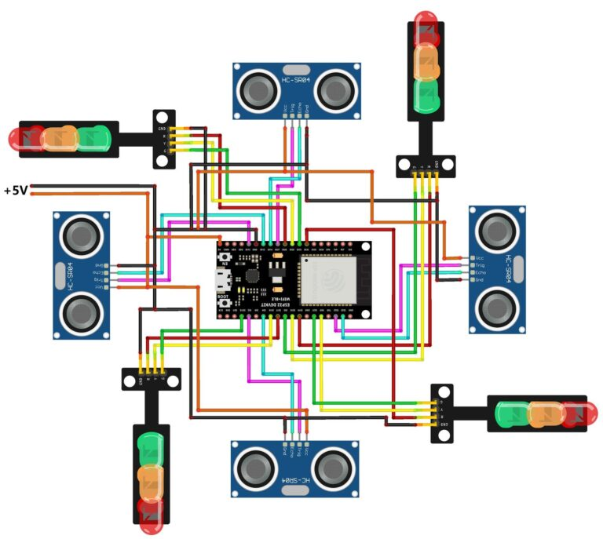
CIRCUIT DIAGRAM

Slide 9
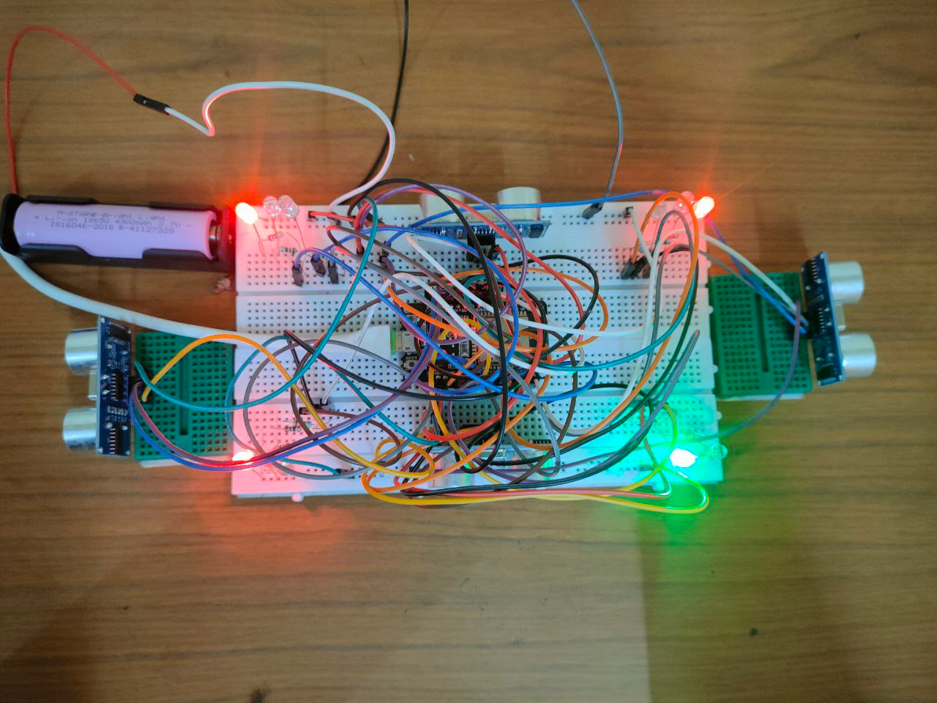
FINAL MODEL

Slide 10
RESULT:
In conclusion, the IoT-based traffic monitoring system we have designed using ESP32 and ultrasonic sensors offers a sophisticated solution for modern traffic management. By leveraging AWS server for data analysis, we enable real-time monitoring and actionable insights that can greatly enhance traffic flow efficiency and safety.

Slide 11
Problem faced and Rectified
Problem faced | Rectification solution
Power shortage | added an additional battery to overcome power shortage
2. Data management and analysis | Collecting and analyzing data from traffic sensors and control devices is crucial for effective traffic management. Implementing robust data management practices and using analytics tools can help derive valuable insights from the data.

